Slide 1
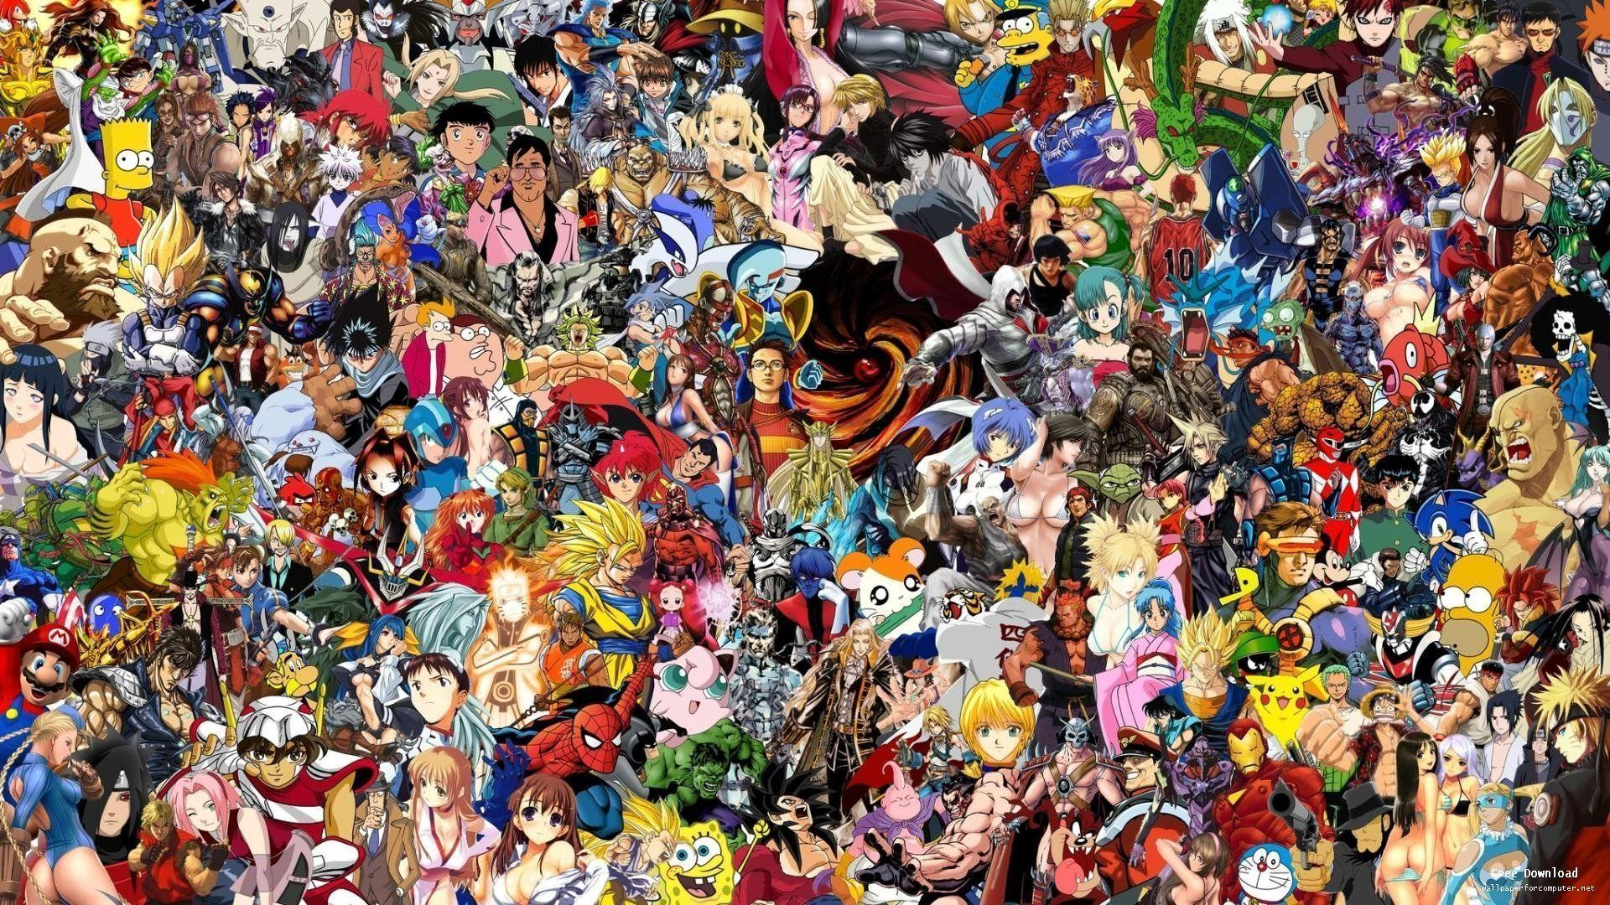
Video Game Sales
Corey Zwisler
Irfanullah Ghaffar
Anthony Thepsourinthone

Slide 2

Objectives
Video Game Sales in the U.S.
Using Machine Learning to predict the future Sales.

Slide 3
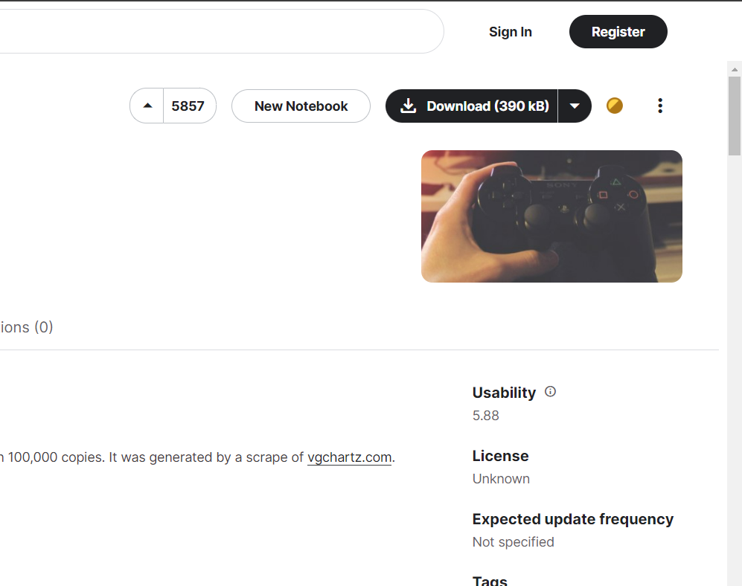
KAGGLE

Slide 4

CSV Files
Python/Pandas
Numpy
Sklearn
Matplotlib
Data Cleanup
Analyzation
Decision Tree
Tableau
Data Visualization

Slide 5
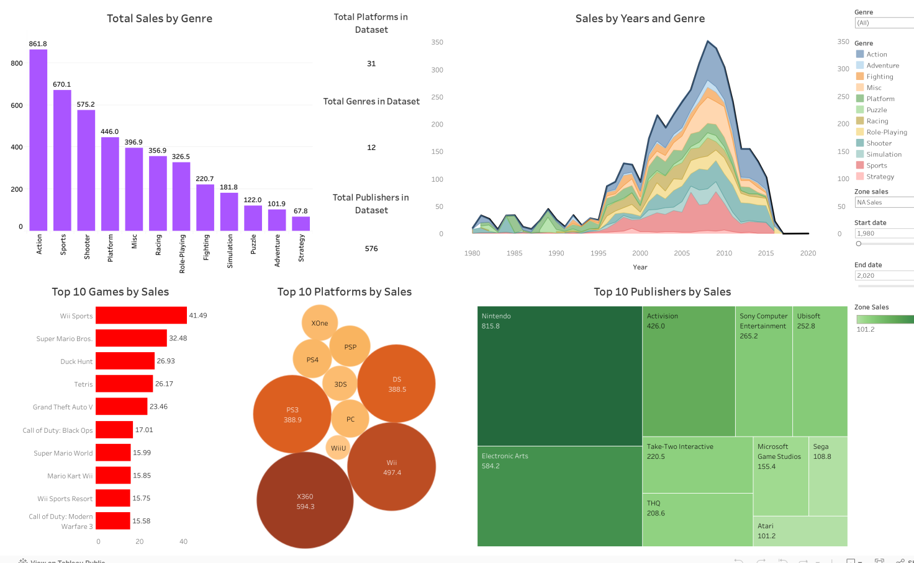
Tableau

Slide 6
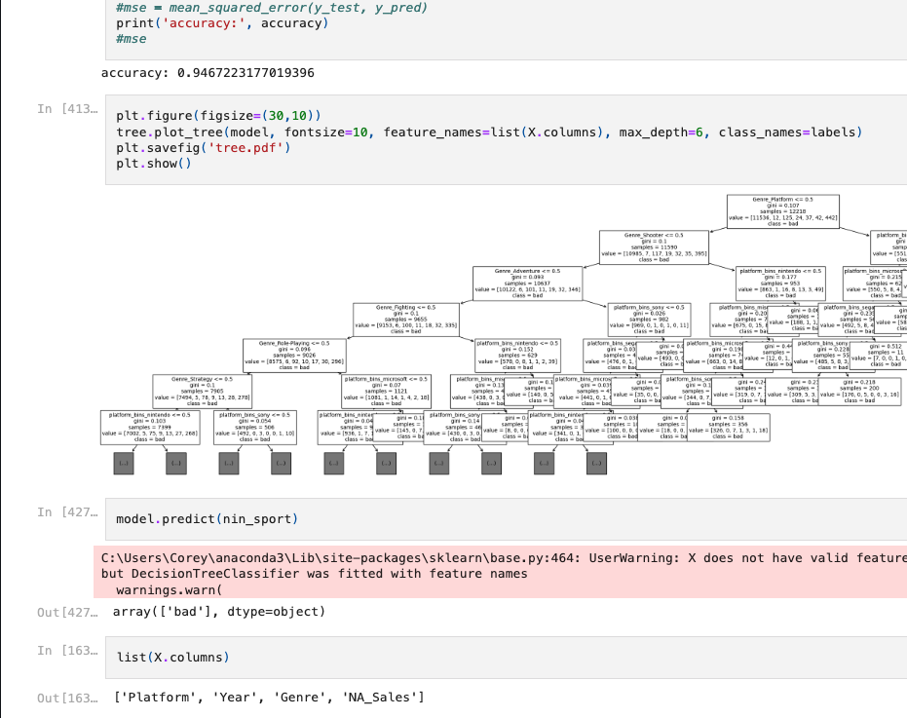
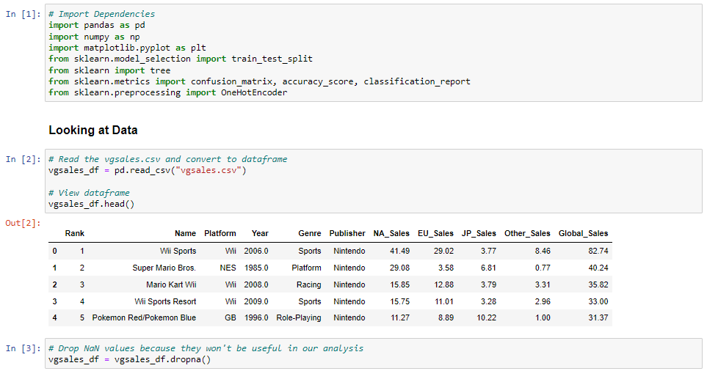
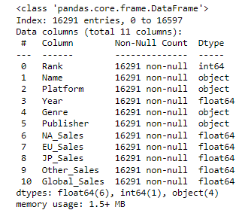
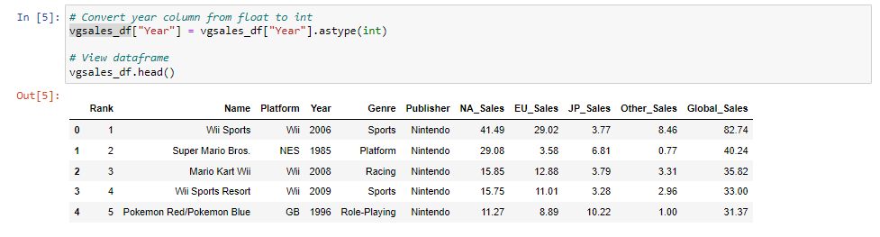
Python/Pandas
What does our data look like?
Imported dependencies
Read csv
Checked data types
Noticed the ‘Year’ column loaded as a float
Converted the ‘Year’ column into an integer dtype

Slide 7
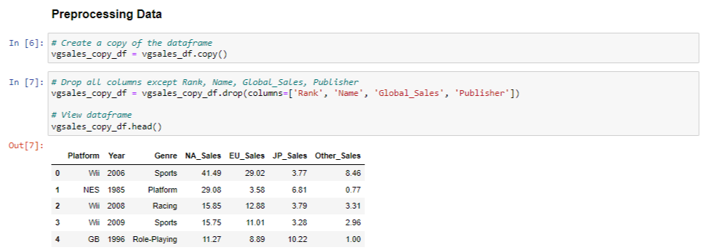
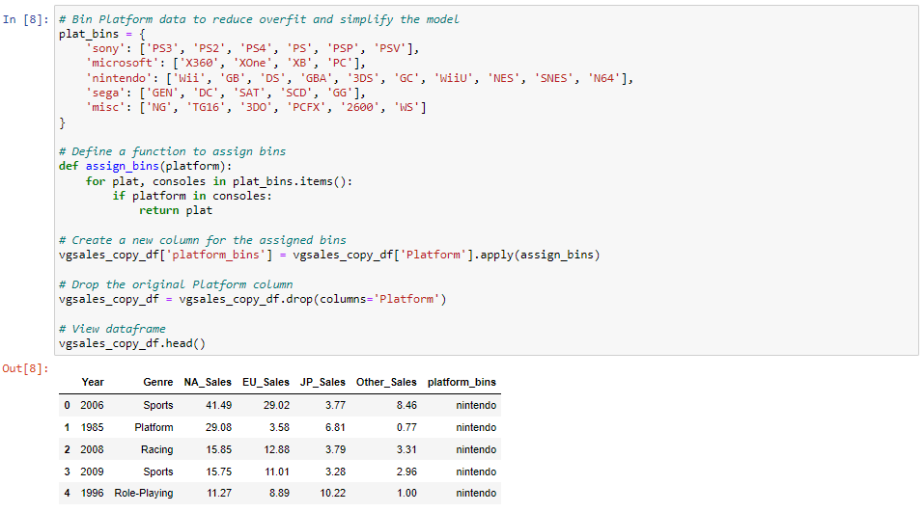
Python/Pandas
The art of preprocessing!
Created a copy of the dataframe
Dropped columns that we did not intend on using for our model
Created bins for the ‘Platform’ column to simplify the data and prevent overfitting
Created a new column ‘platform_bins’ to store bins and dropped the ‘Platform’ column

Slide 8
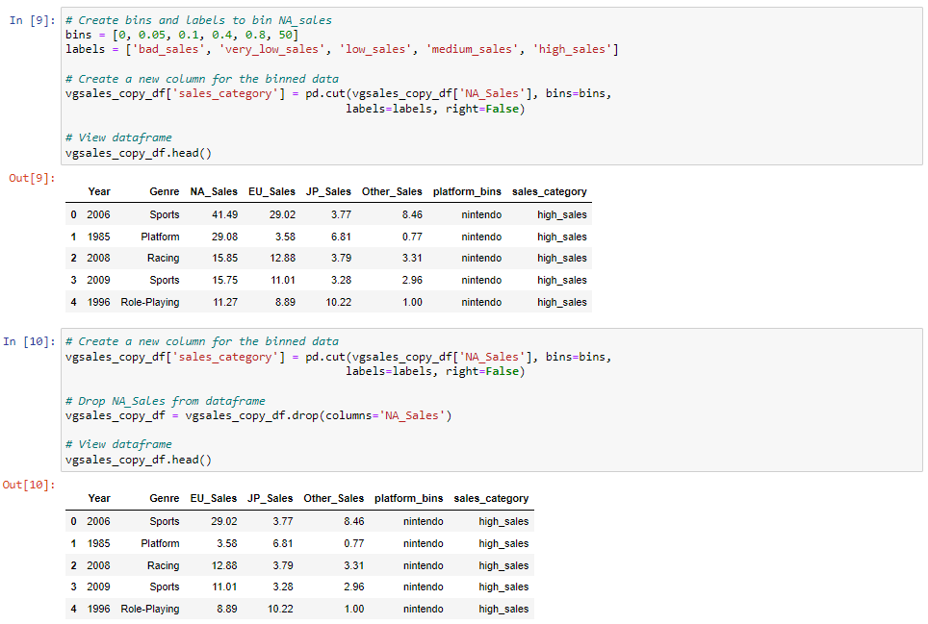
Python/Pandas
The art of preprocessing!
Created bins to sort the ‘NA_Sales’ column to simplify the data and prevent overfitting
Created a new column ‘sales_categories’ to store bins
Dropped the ‘NA_Sales’ column

Slide 9
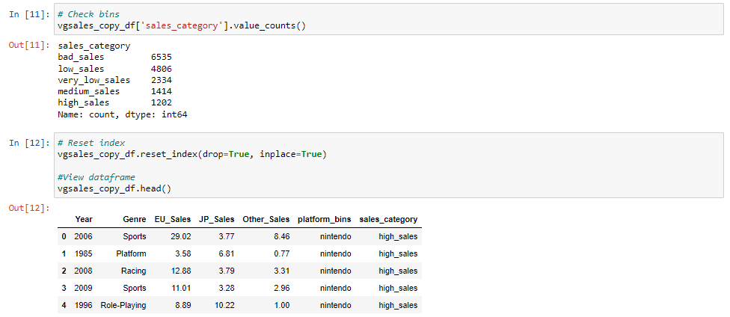
Python/Pandas
The art of preprocessing!
Checked bins
Reset the index since we manipulated the dataframe

Slide 10
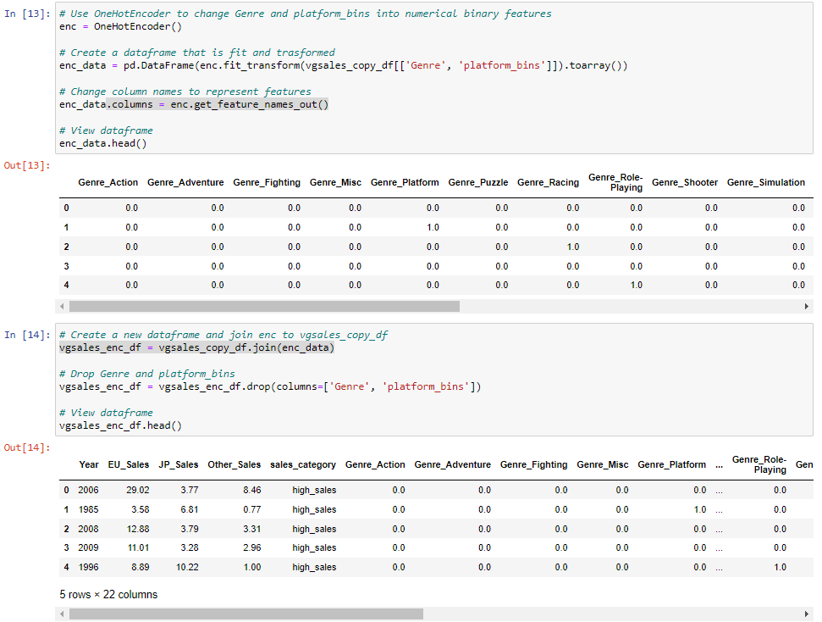
Python/Pandas
The art of preprocessing!
Used OneHotEncoder to change ‘Genre’ and ‘platform_bins’ from categorical data to numerical data
Joined the encoded columns to the copied dataframe
Dropped the ‘Genre’ and ‘platform_bins’ columns

Slide 11
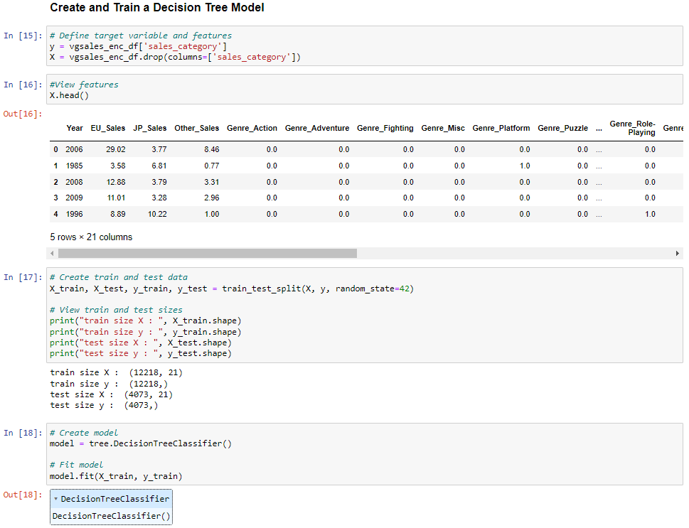
Python/Sklearn
Creating and training our model!
Defined our target variable and features
Created train and test data
Created a Decision Tree Model
Fit the training data to the model

Slide 12
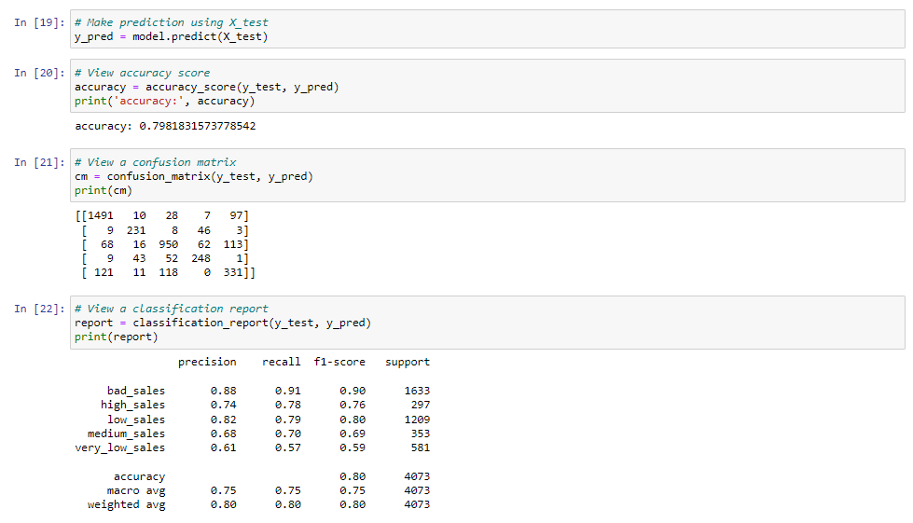
Python/Sklearn
How well did it predict?
Made predictions using test data
Looked at accuracy score
Generated a confusion matrix
Generated a classification report

Slide 13
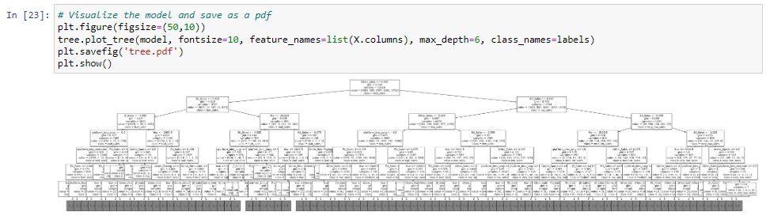
Look at that Tree!

Slide 14
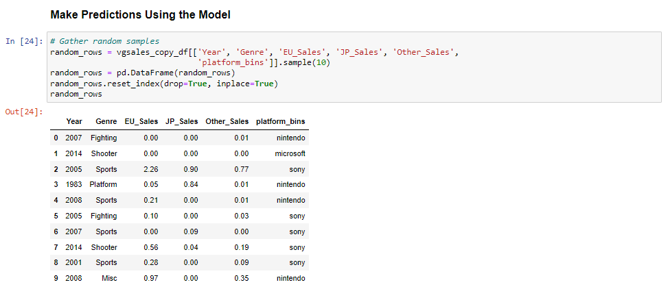
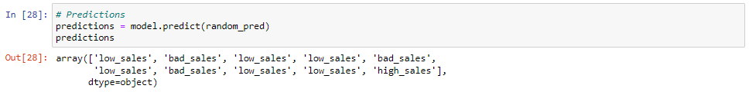
Python/Sklearn
Let’s make some predictions!
Gathered random samples from data
Repeated the preprocessing steps to create data that could be passed through the model
Generated predictions

Slide 15
Questions?

Slide 16
Thank you!

